Slide 1

Supreme Court Judgement Prediction
Presented by - Ninad Gajbhiye

Slide 2
HELLO! I’m Ninad
Its a pleasure to present this topic So I’m going to discuss about Supreme court judgement Prediction using NLP and LSTM

Slide 3
INTRODUCTION
01

Slide 4
Artificial intelligence is being utilized in many domains as of late, and the legal system is no exception. However, as it stands now, the number of well-annotated datasets pertaining to legal documents from the Supreme Court of the United States (SCOTUS) is very limited for public use. Even though the Supreme Court rulings are public domain knowledge, trying to do meaningful work with them becomes a much greater task due to the need to manually gather and process that data from scratch each time. Hence, our goal is to create a high-quality dataset of SCOTUS court cases so that they may be readily used in natural language processing (NLP) research and other data-driven applications. Additionally, recent advances in NLP provide us with the tools to build predictive models that can be used to reveal patterns that influence court decisions. By using advanced NLP algorithms to analyze previous court cases, the trained models are able to predict and classify a court's judgment given the case's facts from the plaintiff and the defendant in textual format; in other words, the model is emulating a human jury by generating a final verdict

Slide 5
OBJECTIVE
02

Slide 6
Supreme Court Judgement Prediction
The dataset contains 3304 cases from the Supreme Court of the United States from 1955 to 2021. Each case has the case's identifiers as well as the facts of the case and the decision outcome. Other related datasets rarely included the facts of the case which could prove to be helpful in natural language processing applications. One potential use case of this dataset is determining the outcome of a case using its facts.Target Variable: First Party Winner, if true means that the first party won, and if false it means that the second party won.
Acknowledgements :Mohammad Alali, Shaayan Syed, Mohammed Alsayed, Smit Patel, Hemanth Bodala

Slide 7
FLOWCHART
03

Slide 8
Supreme Court Judgement Prediction
Data Collection
Data Pre-processing
Sentiment Analysis

Slide 9
Data Description
04

Slide 10
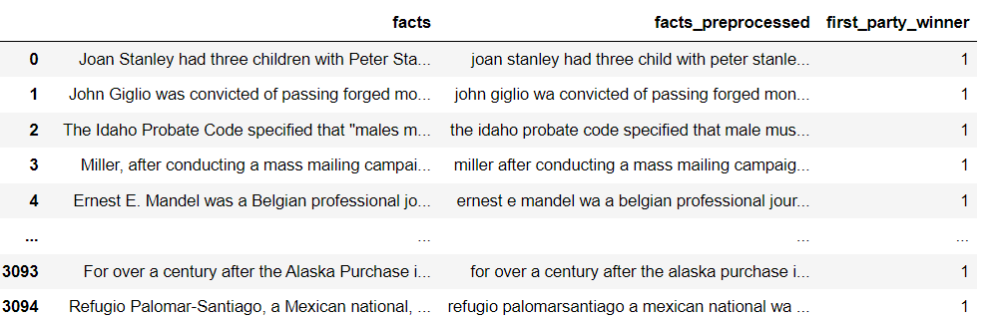
Supreme Court Judgement Prediction
The dataset contains 3304 cases from the Supreme Court of the United States from 1955 to 2021. Each case has the case's identifiers as well as the facts of the case and the decision outcome.

Slide 11
Data Preprocessing
05

Slide 12
Supreme Court Judgement Prediction
1.Converting Lowercase
2.Remove URL links
3.Remove Punctuation
6.Common words
5.Extra Whitespace
4.Lemmatization

Slide 13
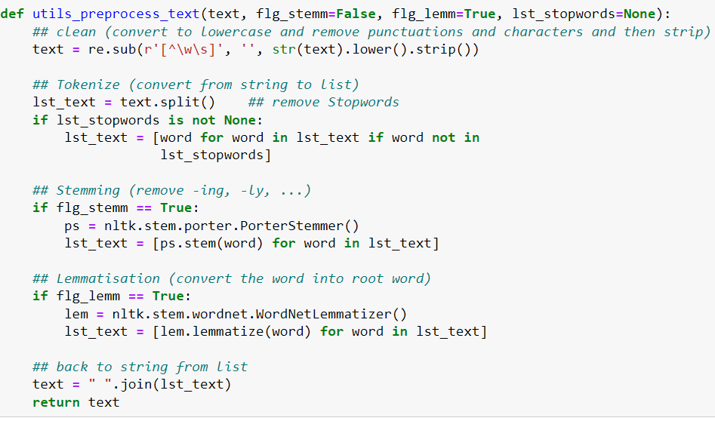
The provided code is part of my project, where I've implemented a user-defined function to streamline text preprocessing tasks like removing punctuation, stopwords, and converting text to lowercase. Combining these steps into a single function enhances efficiency and facilitates reuse across the project.

Slide 14
Visualization
06

Slide 15
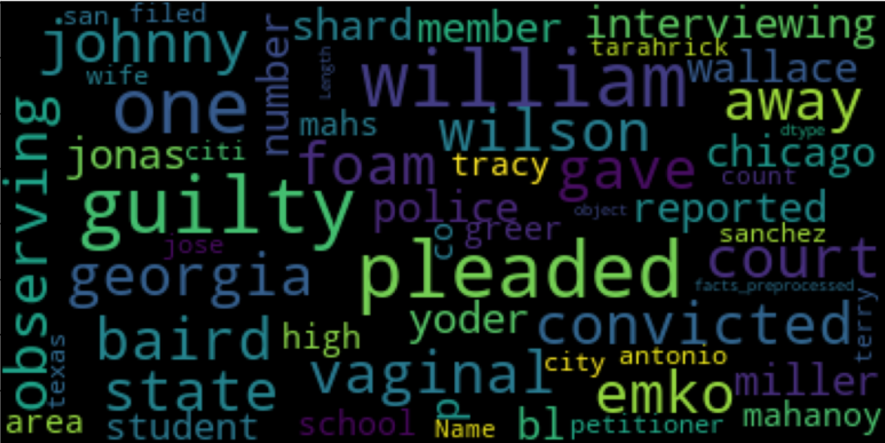
Supreme Court Judgement Prediction
Wordcloud is the pictorial representation of the most repeated words
The above representation gives us idea about the most repeated words for facts column

Slide 16
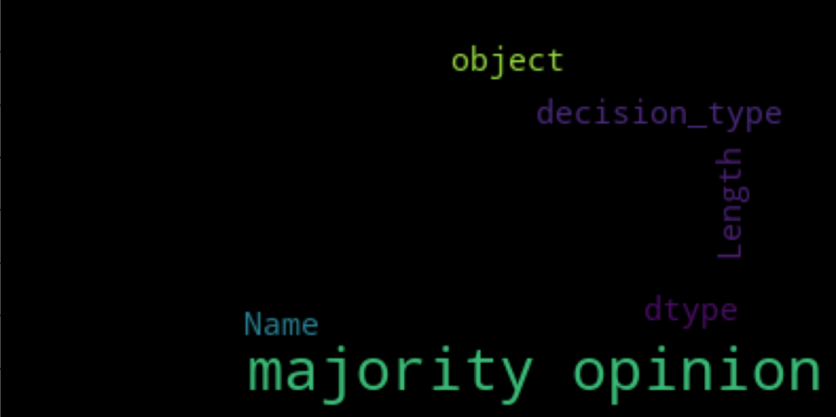
Supreme Court Judgement Prediction
This representation gives you the idea about most of decision types happened in a court case

Slide 17
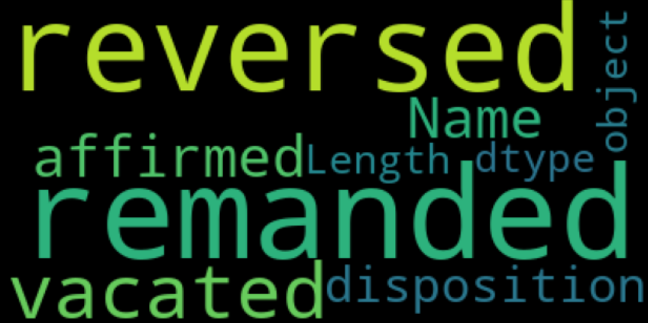
Supreme Court Judgement Prediction
This representation gives you the idea about most word appeared in disposition column disposition is basically a person inherent qualities of mind and character

Slide 18


Supreme Court Judgement Prediction
This Image tells you that its performing good for class one which was my target variable
b. This image tells you the performance of the same data but by using LSTM
Representation of Judgements Prediction who belong to first party winner with the help of confusion matrix

Slide 19
Advantages
07

Slide 20
Advantages of Sentiment Analysis
Insight Generation: Sentiment analysis provides valuable insights into public opinion, customer feedback, and market trends, aiding decision-making processes.
Efficiency: It automates the analysis of large volumes of text data, saving time and resources compared to manual review methods.
Real-Time Monitoring: It enables real-time monitoring of sentiment across various platforms, allowing prompt responses to emerging trends or issues.
Personalization: By understanding individual sentiment, it facilitates personalized recommendations, marketing strategies, and customer experiences.

Slide 21
Advantages of LSTM
Long-Term Dependency: LSTMs can capture long-range dependencies in sequential data, making them effective for tasks requiring memory of past events or context.
Handling Variable-Length Sequences: They can process sequences of varying lengths, making them adaptable to tasks where input lengths may vary, such as natural language processing.
Feature Learning: LSTMs automatically learn relevant features from input data, reducing the need for manual feature engineering and improving model performance.
Robustness to Noise: They are robust to noisy and sparse data, enabling effective learning even from imperfect or incomplete datasets.

Slide 22
Applications
08

Slide 23
Application of Sentiment Analysis & LSTM
Application of Sentiment Analysis
Application of LSTM
Speech Recognition
Time Series Forecasting
Healthcare
Gestures Recognition
Robotics
Social Media Monitoring
Customer Service
Stock Market Prediction
Brand Monitoring
Political Analysis

Slide 24
THANK YOU!
ninadgajbhiye@gmail.com
Do you have any questions?

